Slide 1
Sales Analysis Dashboard – Tableau
Sales Data (2003–2005)
Prepared by: Aadhya MD Elevate Labs Internship

Slide 2
Project Overview
Analyzed sales performance using sales_data_sample.csv dataset
Built interactive dashboard using Tableau
Included KPIs, bar chart, line chart, treemap, and filled map
Filters: Country, ProductLine, Year

Slide 3
Dataset Description
Content:
Rows: 2823
Columns: 25
Fields include:
ProductLine
Country
OrderDate
QuantityOrdered
PriceEach
Sales
DealSize

Slide 4
KPIs
Total Sales: 10,032,629
Total Quantity Sold: 99,067
Average Price: 236.168

Slide 5
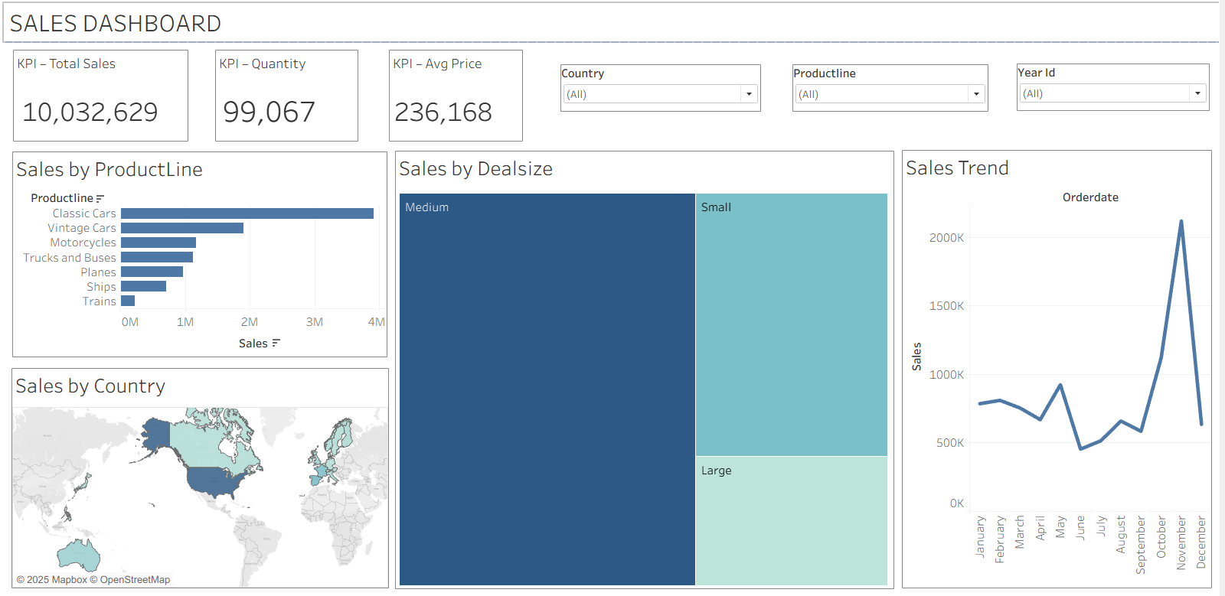
Main Dashboard
Sales Dashboard — Complete View (Non-Filtered)

Slide 6
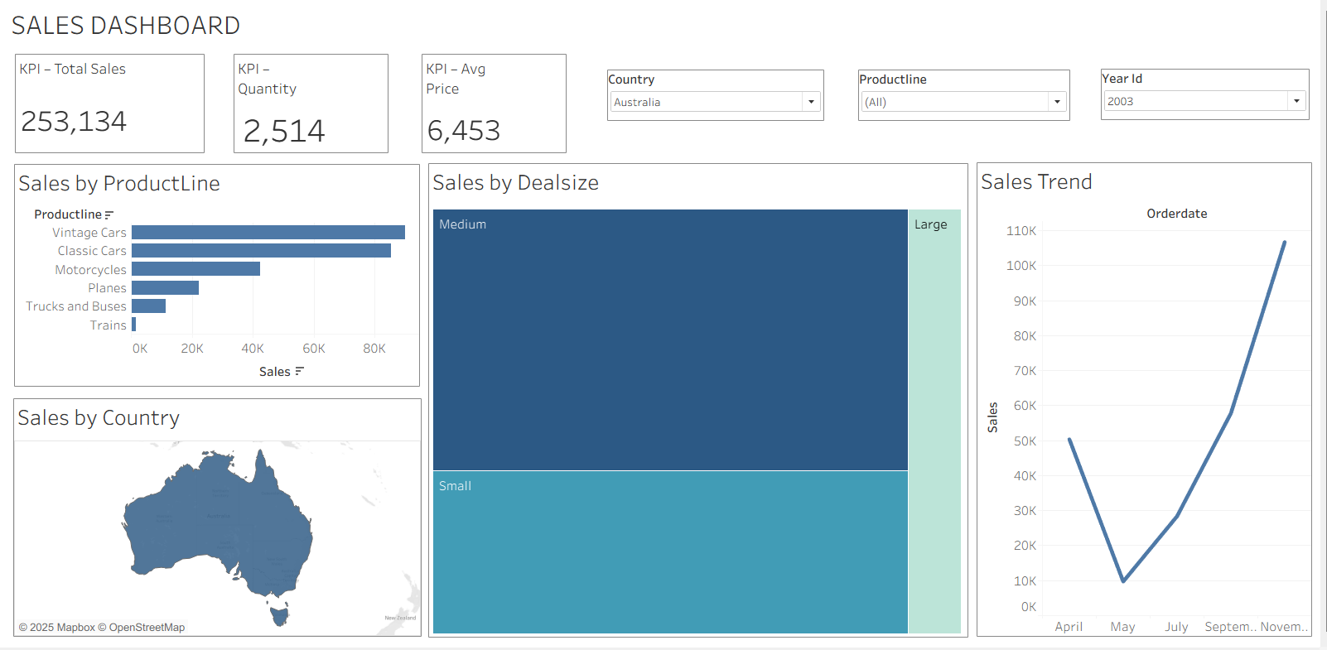
Filtered Dashboard 1
Dashboard View — Country: Australia | Year: 2003

Slide 7
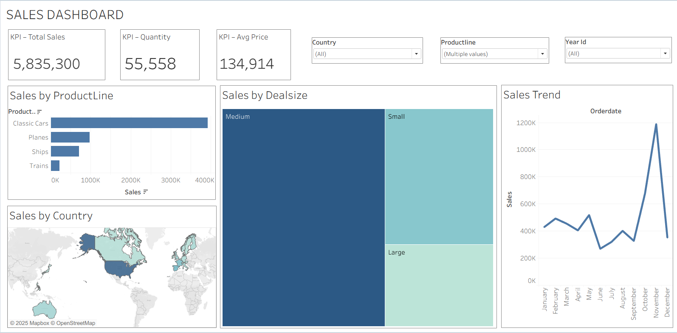
Filtered Dashboard 2
Dashboard View — Country: USA | Multiple ProductLines

Slide 8
Key Insights
Classic Cars generates the highest revenue
USA is the strongest market
November has the highest monthly sales
Medium Deal Size dominates sales contribution
Ships and Trains contribute least

Slide 9
Tools Used
Tableau Public
CSV Dataset
GitHub
PowerPoint

Slide 10
Conclusion
The dashboard provides a complete view of product performance, regional sales distribution, and seasonal patterns.
It can help business teams identify high-performing product lines and plan for peak sales periods.

Slide 11
THANK YOU

